Slide 1

CONCRETE STRENGTH PREDICTION
Project Supervisor : Dr.M.Kanipriya, M.E., Ph.D
Name of the Student : Mounika.Vajrala
Register Number : 39111050

Slide 2
Presentation Outline
Course Certificate
Introduction
Objectives
System Architecture/Ideation Map
Project Implementation
Methodology/Model Building
Results and Discussion
Conclusion
References

Slide 3

Course Certificate

Slide 4
Abstract
The compressive strength of concrete determines the quality of the concrete.
To Predict Concrete strength of concrete with maximum accuracy, for various quantities of constituent components.
Using random forest regression we achieve to predict the Strength of the Concrete.

Slide 5
Objectives
To evaluate nature of concrete strength gain pattern with time for a particular type of mix.
To develop a simple relation which has the potential to predict the compressive strength of the concrete.
The objective of this project is trying to predict the concrete compressive strength based important predictors.

Slide 6
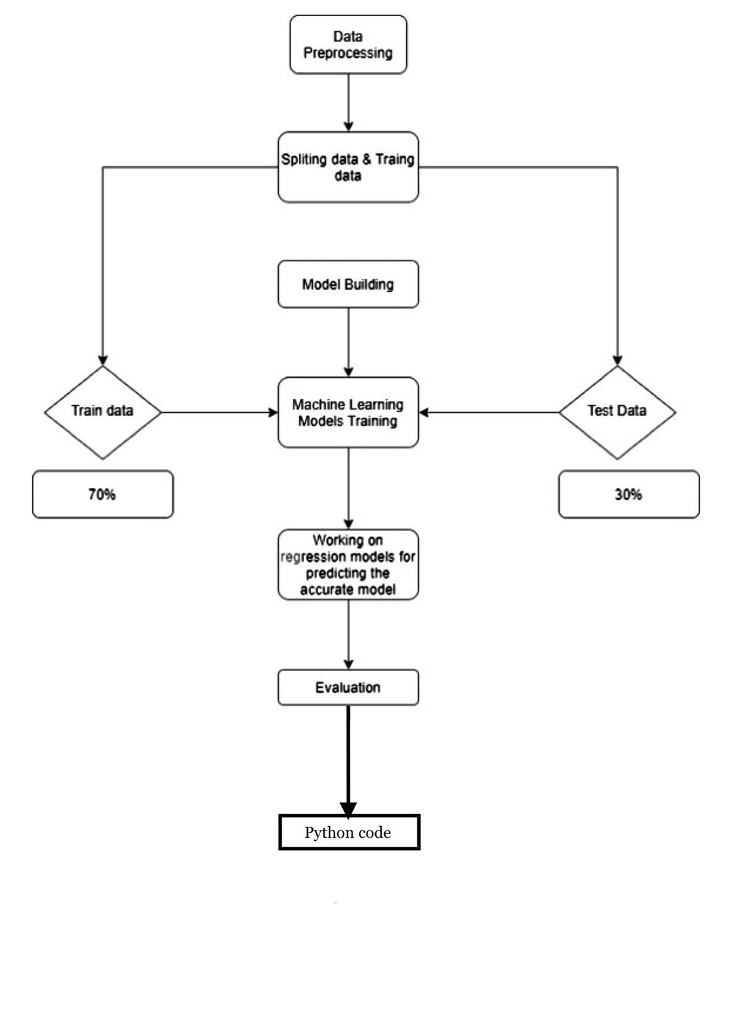
Architecture Diagram

Slide 7
Project Implementation
Software Requirements
Jupyter Notebook - Project environment
Numpy – Used to convert 1D arrays to 2D arrays
Pandas – Convert dataset into data-frame
Matplot , Seaborn – Used to visualize the dataset
SkLearn module – To import all types ML algorithms
Hardware Requirements
Any Operating System

Slide 8
Project Implementation
The Project was designed to calculate and to predict the Strength.
Jupyter Notebooks and Google colab.
Creating random forest model for training and testing the data.
Measuring the strength of concrete by trained data.
Getting the accuracy of it and analyzing the predicted values from the original ones.

Slide 9
Methodology/Model Building
To get the resulted output by the approach of Random forest.
Applying several machine learning algorithms like Linear regression ,Decision tree regression and Random forest regression to training data.
Using random forest regression we achieve to predict the Strength of the Concrete because,it is the best model when compared to other models.

Slide 10
Results and Discussion
By applying the RandomForestRegressor model, the predicting values are quite similar to our original values.
To evaluate the strength of concrete by predicting the values from original ones.
For simplicity of discussion, RMSE is used as the primary metric of performance.

Slide 11
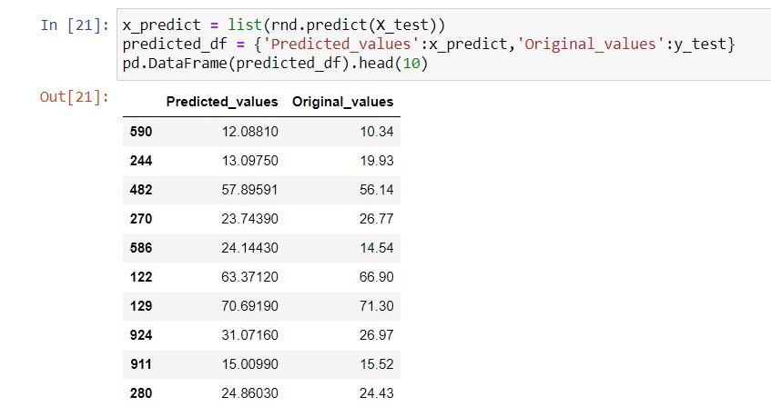
Results and Discussion

Slide 12
Conclusion
In this analysis, we evaluate the predictive performance of the Concrete Strength by Machine Learning models.
We conclude that the Concrete strength can be predicted by random forest which has the best accuracy state.

Slide 13
References
 | [1] Ahmadi-Nedushan B ,”An optimized instance based learning algorithm for estimation of compressive strength of concrete” . “Engineering applications of Artificial Intellegence 25 (5)”,pp:-1073-1081,2012. [2] Vapnik V,Golowich SE,Smola A,”Support vector method for function approximation,regression estimation,and single processing” . ”Advances in Neural Information Processing Systems 9”,pp:-281-287,1997. [3] Moutassem.F,Chidiac,”SE Assesment of concrete strength prediction models”. ”Springer”,pp:-343-358,2016. [4] Yeh IC,”Modelling concrete strength with augmentneuron networks”.”Journal of materials in civil engineering 10(4)”,pp:-263-268,1998.

